Slide 1
SMART AI STUDY PLANNER
Plans for today and tomorrow
TEAM:TRINITY

Slide 2
TABLE OF CONTENTS
1. | PROBLEM STATEMENT
2. | SMART AI STUDY PLANNER
3. | TECHNICAL APPROACH
4. | FEASIBILITY AND VIABILITY
5. | BENEFITS
6. | USER - EXPERIENCE

Slide 3
PROBLEM STATEMENT
Why build “AI Smart Study Planner”?
Students today face a very real problem—not a lack of resources, but too many disconnected tools.
Students typically:
Jump between apps for notes, flashcards, and mock tests
Do not know how to prioritize weak subjects
Waste time deciding what to study next
Lack personalized guidance unless they hire expensive tutors
Even with powerful tools like Google search or video platforms, the learning process remains :
❌ Manual
❌ Unstructured
❌ Not adaptive

Slide 4
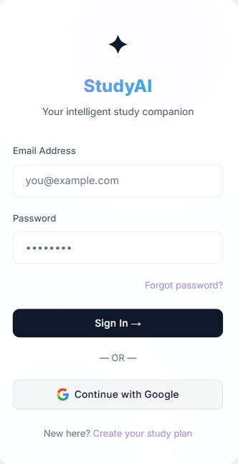
SMART AI STUDY PLANNER
Generates a personalized day-wise study plan using AI (via Groq ) based on syllabus, goals, and exam date.
Converts syllabus into structured, exam-oriented notes with key points and important questions.
Creates intelligent flashcards for active recall and better memory retention.
Builds custom mock tests with user-defined patterns for realistic exam practice.
Improves focus and productivity with an integrated Pomodoro timer system.
Converts AI-generated notes and content into audio. Allows students to listen instead of reading

Slide 5
TECHNICAL APPROACH
The frontend is built using HTML for structure, CSS for styling and responsive design, and JavaScript (with React) to create dynamic, interactive user interfaces.
It handles user input, displays AI-generated content, and communicates with backend services for real-time updates.
The backend is built using JavaScript with Node.js and integrates AI services like Groq to process user input, generate study content, and handle application logic.
The database uses Firebase to securely store user data, notes, study plans, and authentication details in real time.

Slide 6
FEASIBILITY AND VIABILITY
Feasibility
Uses reliable technologies like React, Firebase, and OpenAI
Easy integration through APIs and ready-made services
Scalable cloud-based infrastructure (no physical setup needed)
Cost-effective with free tiers and pay-as-you-go pricing
Can be developed step-by-step (modular approach)
Viability
High demand for personalized and AI-based learning tools
Combines multiple features (notes, tests, planner) into one app
Monetization via freemium and subscription models
Useful for a wide range of students (school to competitive exams)
Strong potential for growth and future feature expansion.

Slide 7
BENEFITS
1. Personalized Learning
Study plans based on individual goals and performance
2. Better Time Management
Organized schedules and focus sessions
3. Improved Understanding
AI-generated notes simplify complex topics
4. Stronger Memory
Flashcards help in quick revision and retention
5. Exam Confidence
Custom mock tests improve exam readiness
6. Increased Productivity
Task tracking and Pomodoro timer boost efficiency (reducing distractions ).
7. Reduced Stress
Automates planning and organizes study materials

Slide 8
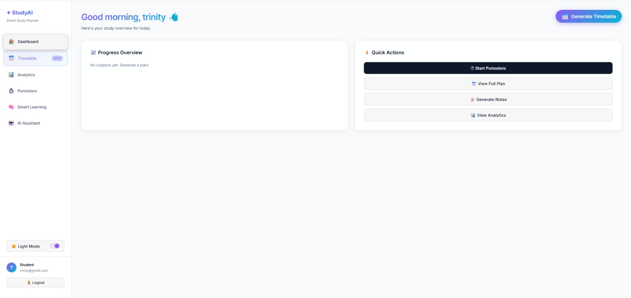
USER - EXPERIENCE
FIGURE 1:DASHBOARD WITH SMART AI FEATURES
(AI-generated study plan ,pomodoro focus timers ,
Smart learning hub , AI academic insights)

Slide 9
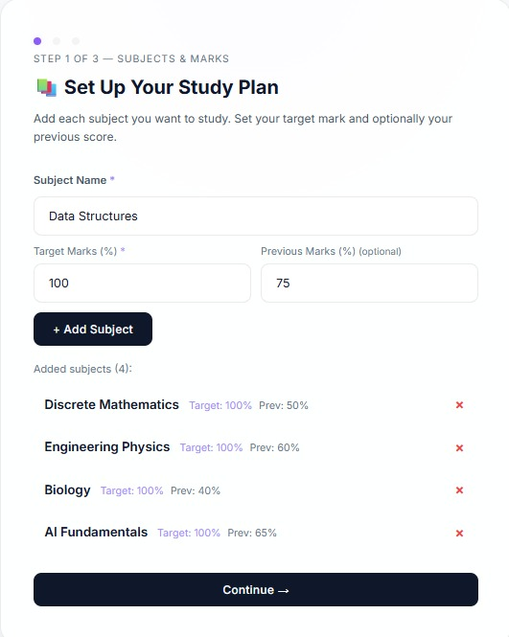
FIGURE 2 : AI GENERATES A STUDY TIMETABLE ACCORDING TO USER
REQUIREMENTS AND PRIORITIES BASED ON ACADEMIC
ANALYTICS.

Slide 10
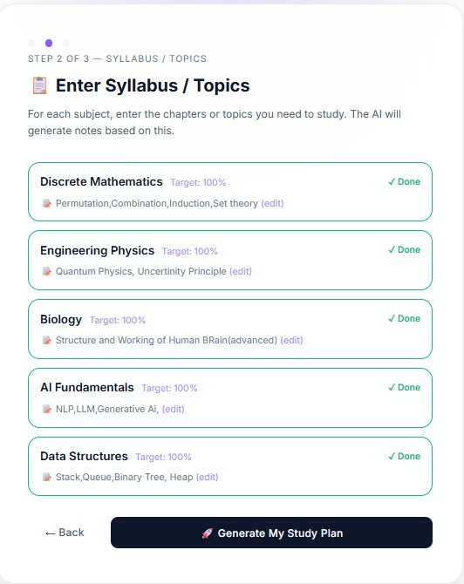
FIGURE 3 : USER CAN ENTER THEIR SYLLABUS TO GENERATE AN IMMACULATE
STUDY PLAN.

Slide 11
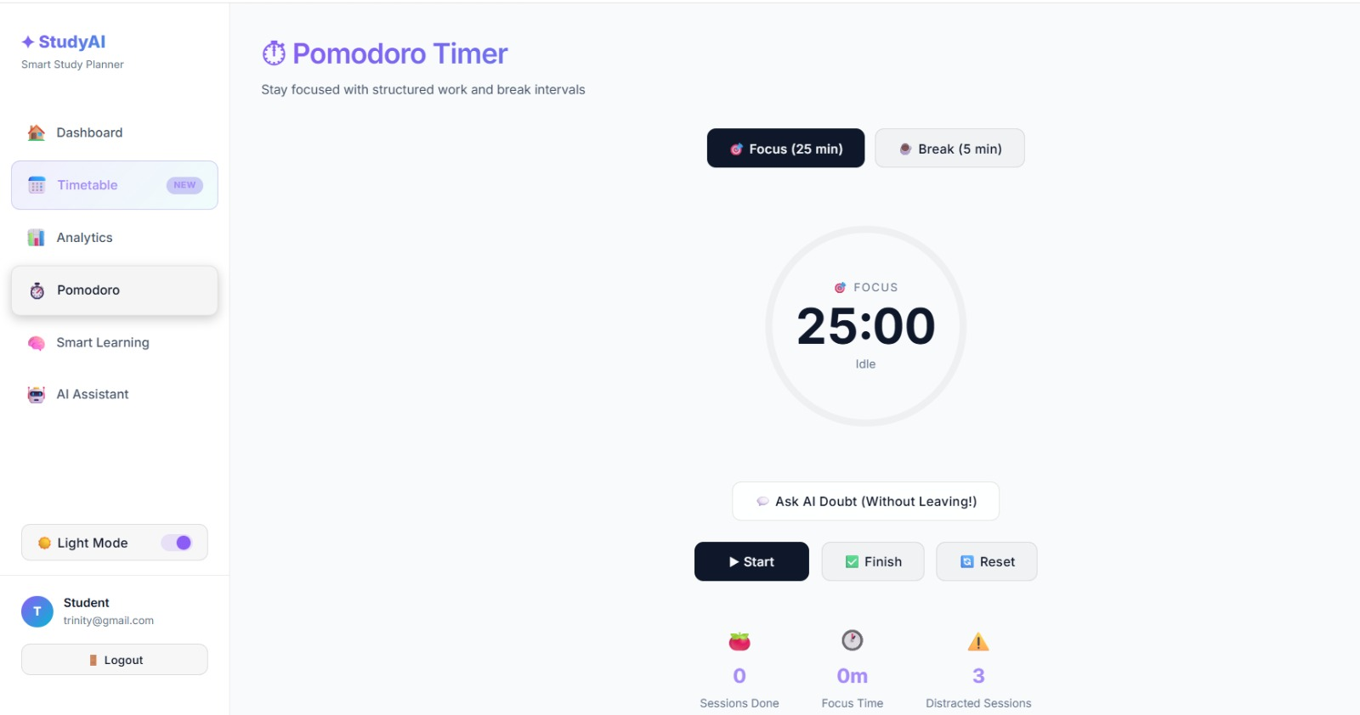
FIGURE 4 : TO ENHANCE THE USER'S FOCUS , POMODORO FOCUS TIMER IS
AMALGAMATED.

Slide 12
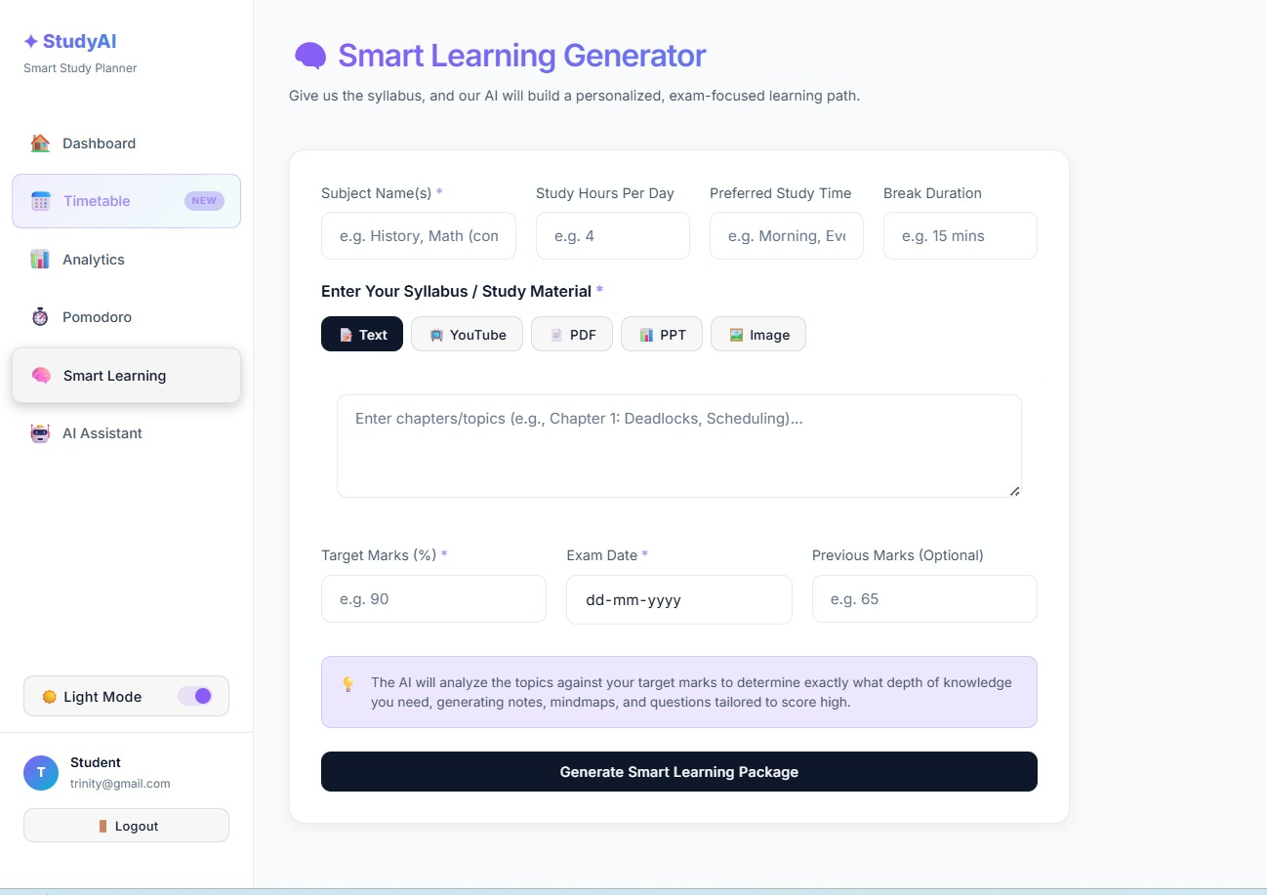
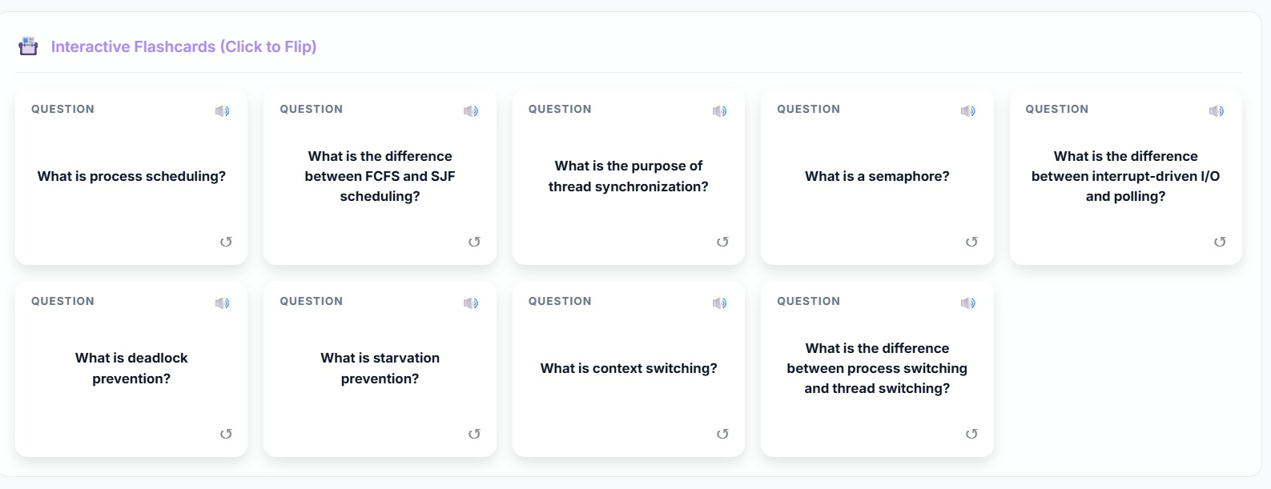
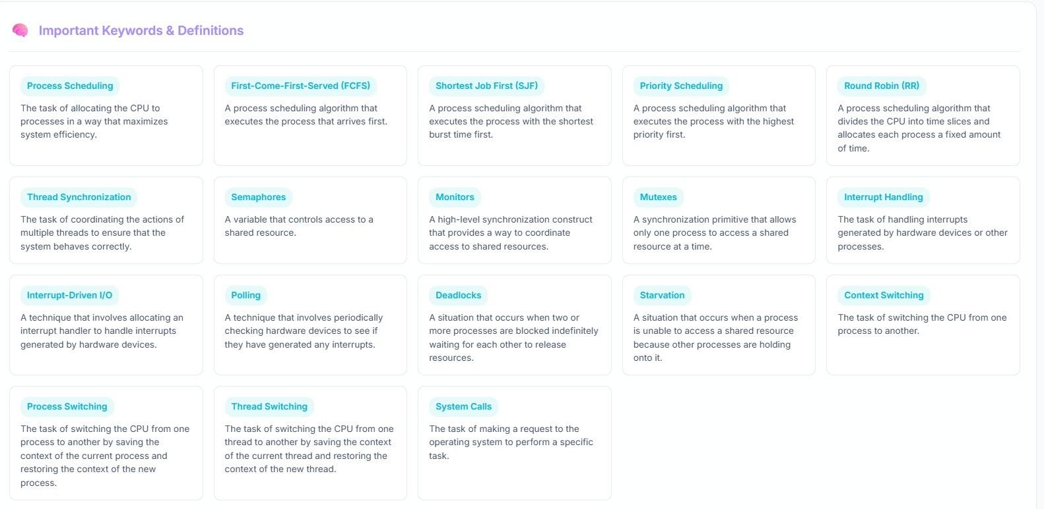
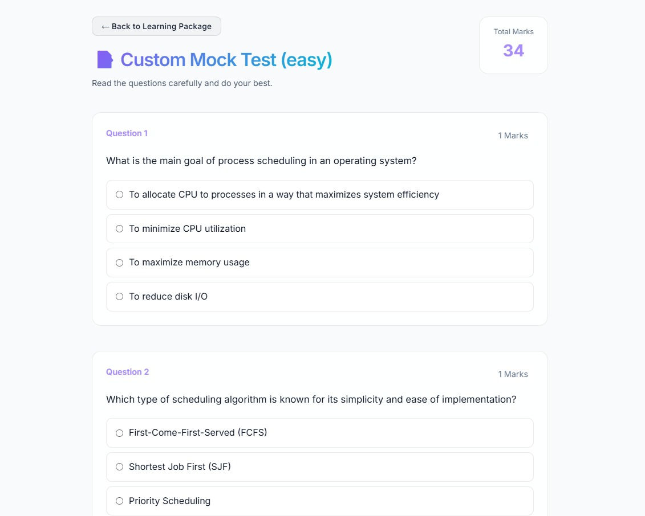
FIGURE 5 :SMART AI-POWERED NOTES GENERATOR
(generates preferred type of notes like text , flowcharts ,
Mind maps , flashcards , keywords , customized mock tests etc...),
It also offers text to speech option.

Slide 13
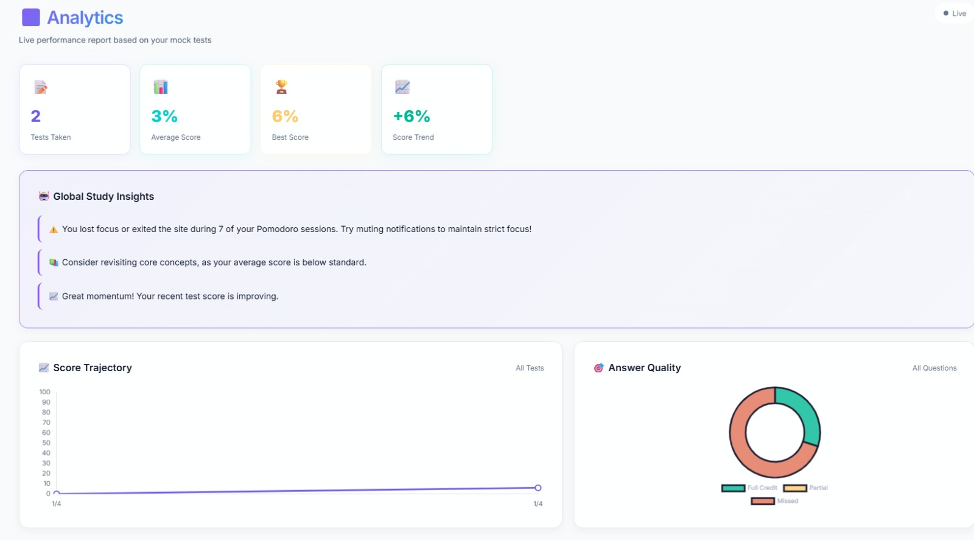
FIGURE 6 : AI ANALYSES USER'S PERFORMANCE.

Slide 14
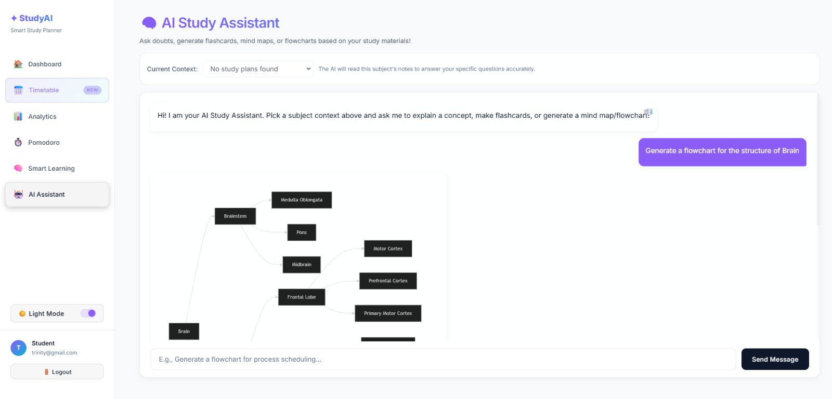
FIGURE 7 : AI ASSISTANCE ASSISTS THE USER THROUGHOUT THE STUDY
SESSION (answers questions instantly like a tutor).

Slide 15
Thank you
TRINITY TEAM MEMBERS:
ARJUN S
NANDHINI V
ALBATHUL I

